Slide 1
Demand Estimation -Agriculture in the US
Abhinav Sridhar
Chaitanya Sumbe
Hitansha A V
Utkarsha Chourasia

Slide 2
Industry Introduction
The Agriculture Industry is the backbone of many countries in the world
Agriculture Sector comprised Farming, Forestry, Fishing and Hunting.
The major products and services in this industry are Crops (42.9%), Animals and animal products (45.2%), Forestry, fishing, Agricultural support services
Agenda
We try to predict the growth of the Industry in next 3 year i.e. ; 2022 to 2024
Using Multiple Linear Regression model (MLR)

Slide 3
Model & Variables
Dependent variables:
Domestic demand : Domestic demand of the agriculture industry in USD (millions)
Independent variables:
Price of feed index: Prices received by the feed producers for all types of livestock. It is an index which is the equally weighted average of monthly means.
Agricultural price index: Index representing prices received for all agricultural activities (crops and livestock) by the farmers.
Price of fertilizer index: Weighted average of the eight most popular fertilizers in the US.
Per capita meat consumption: Total weight of meat consumed by average American in the span of a year.
Trade weighted index: It is the measure of strength of the US dollar to the currency of the nation’s trading partner.

Slide 4
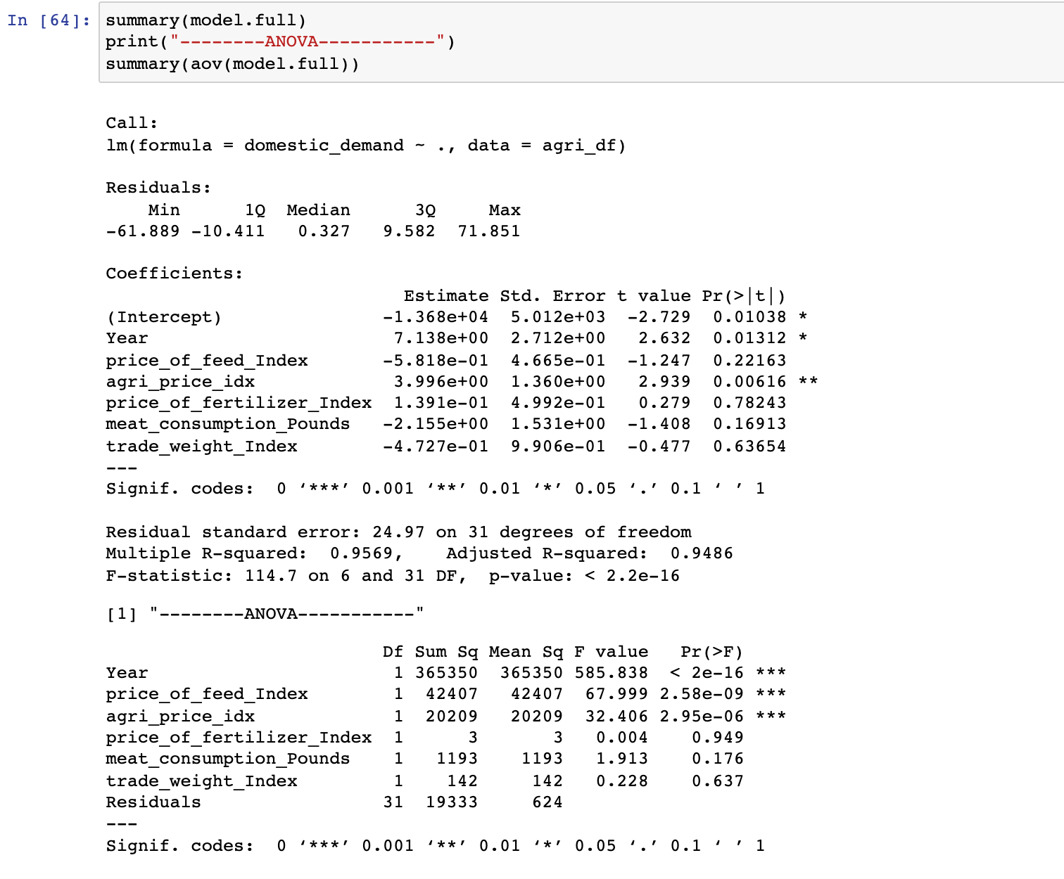
Full Model
dataset consisting of all the variables
R2 value is 0.9569 and adjusted R2 value is 0.9486
94.86% of the changes in the domestic variable i.e. domestic is justified by the independent variables.

Slide 5
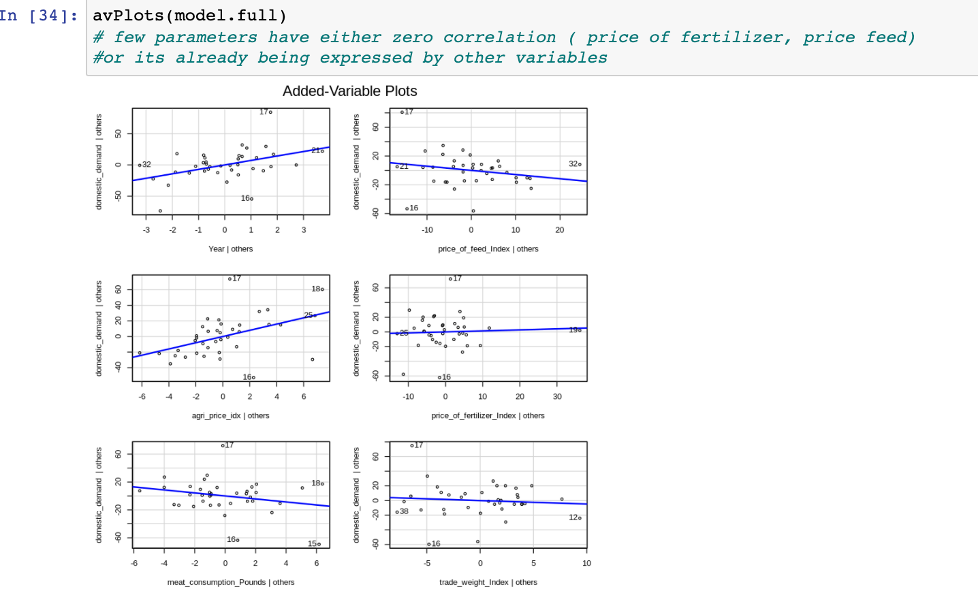
Multivariable analogue – AvPlot
show the relationship between a single x variable and a y variable.
Provides significant explanation for the changes in the domestic demand variable
Few parameters have either zero correlation (price of fertilizer, price feed, TWI) or its effect is already being expressed by other variables.

Slide 6
VIF values – Full Model
Year : 53.9068413328293
price_of_feed_Index : 30.7860138414369
agri_price_idx : 29.4935525839699
price_of_fertilizer_Index : 8.94191839409418
meat_consumption_Pounds : 9.50694518546787
trade_weight_Index : 3.25219919567802

Slide 7
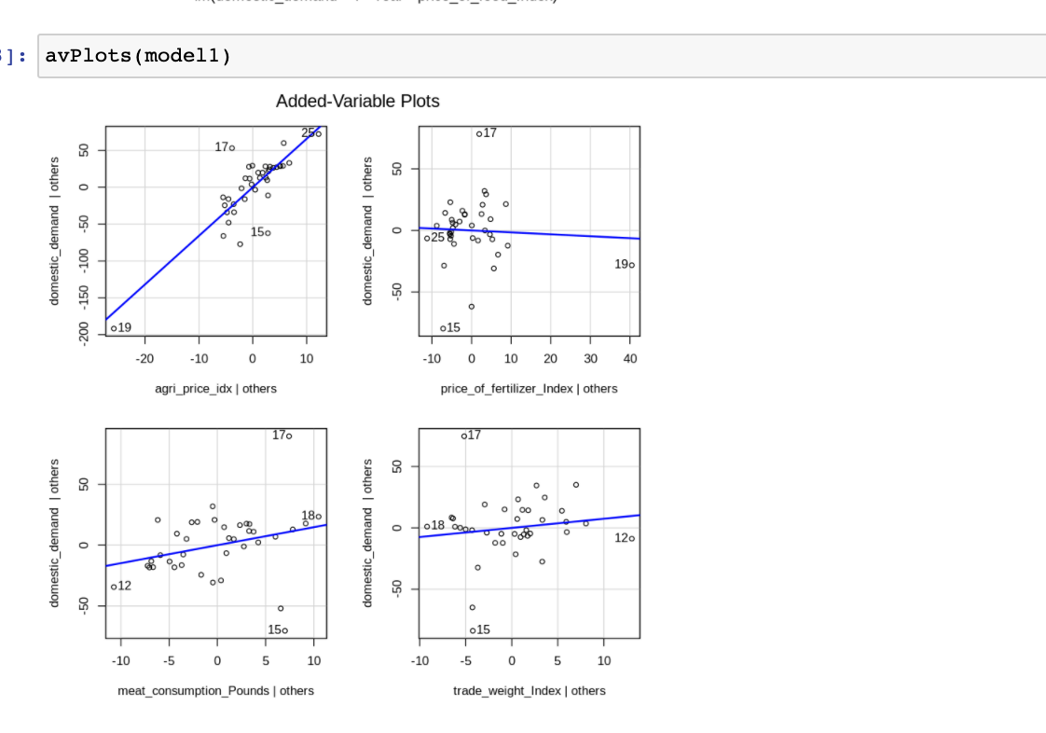
Reduced Model 1 and VIF values
Remove Year and price_of_feed_Index , remodel
Added Variable plot still shows redundancy or no correlation (price of fertilizer idx) or insignificant variable.
VIF
agri_price_idx : 7.7502648112669
price_of_fertilizer_Index : 8.44305954179386
meat_consumption_Pounds : 2.49082419585053
trade_weight_Index : 2.51374808226197

Slide 8
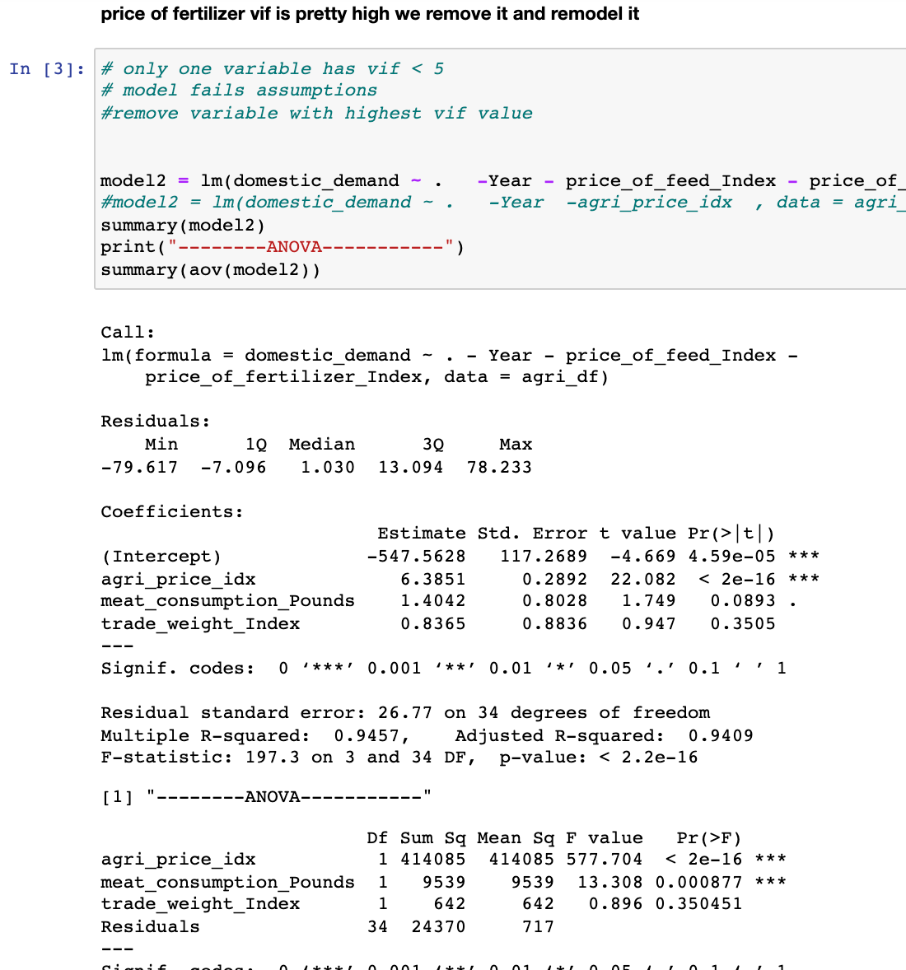
Reduced final model 2
Remove price_of_fertilizer_Index and remodel it
regression equation is:
Domestic Demand =
– 547.5628 + (6.3851 * agricultural price index) + (1.4042 * per capita meat consumption) + (0.8365 * trade weighted index)
R2 value is 0.9457 and adjusted R2 value is 0.9409 , 94.09% changes in domestic demand is expected by predictor variable

Slide 9
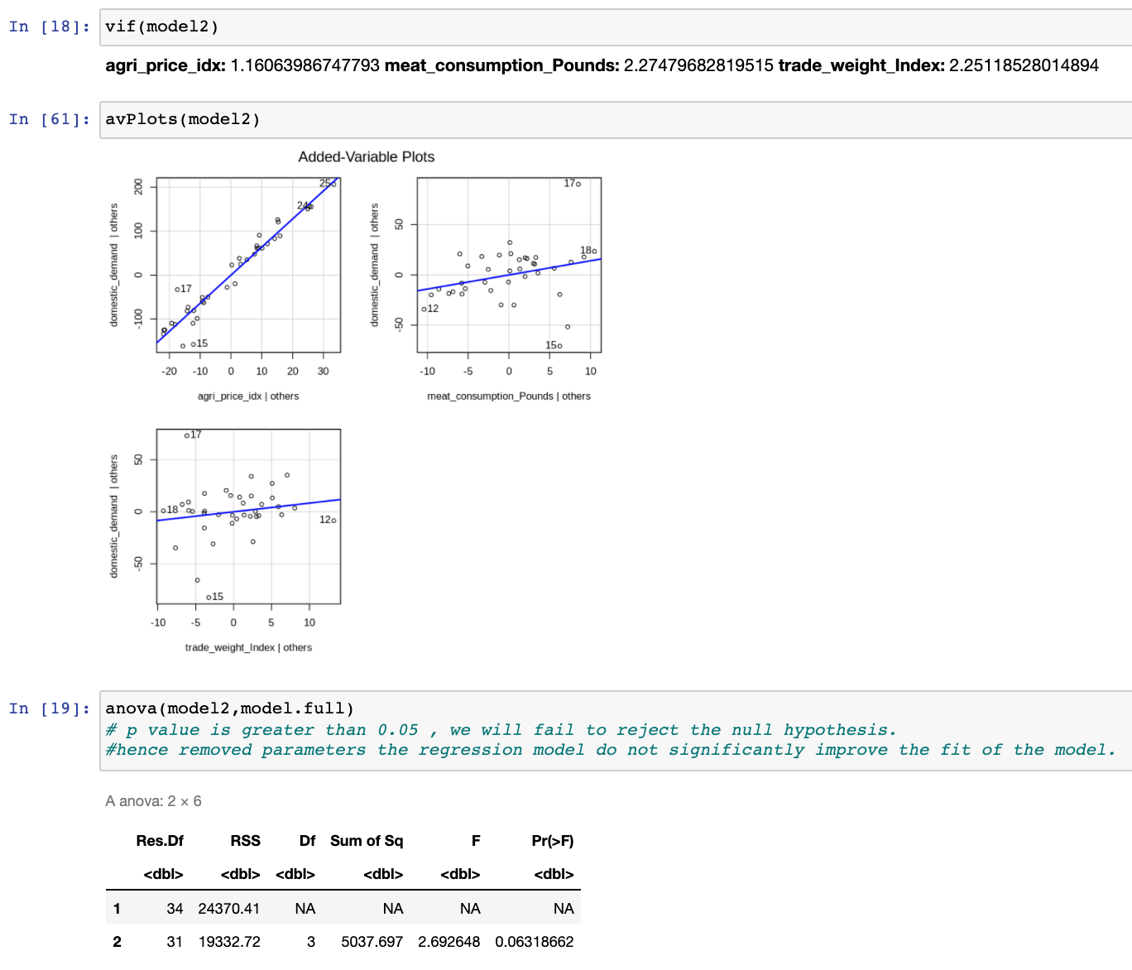
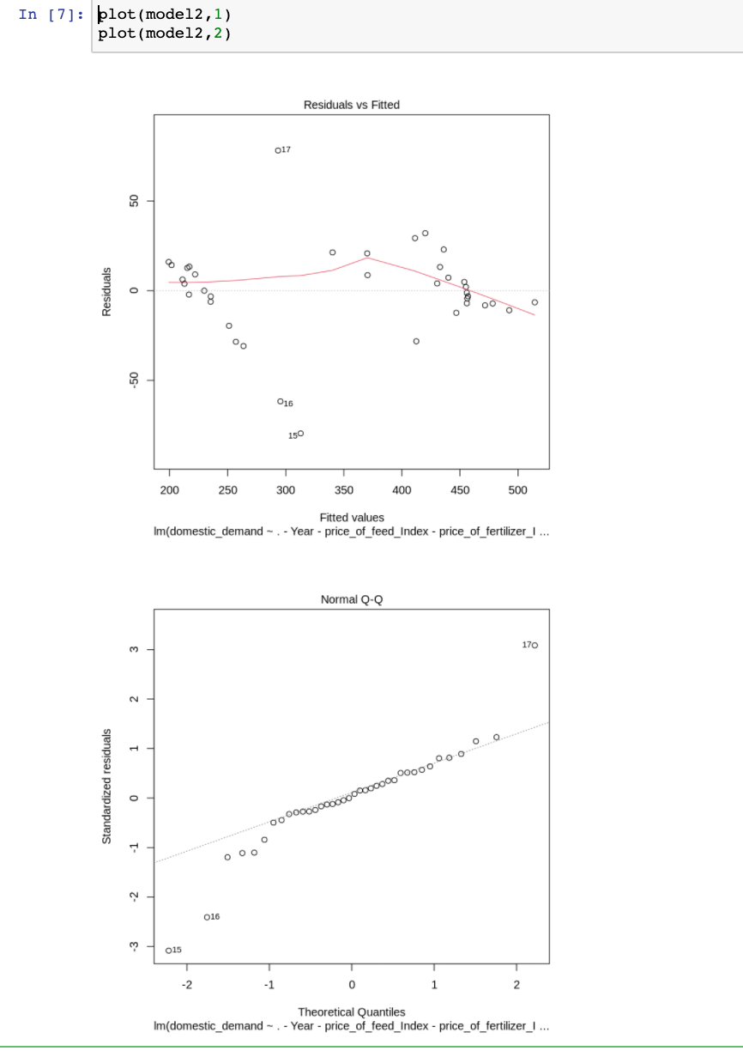
VIF and Added Variable Plot – final model
VIF
agri_price_idx : 1.16063986747793
meat_consumption_Pounds : 2.27479682819515
trade_weight_Index : 2.25118528014894
Added Variable Plot shows the relation of each independent var with dependent var
We see better correlation of variables
We use this model to predict values for next 3 years

Slide 10
Prediction
Using Quadratic trend regression we get corresponding x and y values for year 2022 to 2024
comparing it with values obtained by linear model (model2)
Year | price_of_feed_Index | agri_price_idx | price_of_fertilizer_Index | meat_consumption_Pounds | trade_weight_Index | domestic_demand
2022 | 242.410 | 98.763 | 79.021 | 221.523 | 102.952 | 492.346
2023 | 246.873 | 99.055 | 79.021 | 222.087 | 103.094 | 496.478
2024 | 251.361 | 99.299 | 78.122 | 222.656 | 103.231 | 500.369
Prediction
fit | lwr | upr
480.2381 | 423.6133 | 536.8629
483.0098 | 426.2597 | 539.76
485.4832 | 428.6012 | 542.3651
narrower confidence interval than predicted interval which implies that our accuracy is higher.
Confidence
fit | lwr | upr
480.2381 | 464.5517 | 495.9245
483.0098 | 466.8767 | 499.143
485.4832 | 468.8923 | 502.0741

Slide 11
Conclusion
Data from the previous 35 years. We observe an overall steady increase in Domestic Demand. However, we can observe a dip in 2008 due to the global economic recession. Furthermore, there has been an increase in Domestic Demand ever since 2015.
Variables, which influence the Domestic Demand of Agriculture in the US can be narrowed down to three variables: agricultural price index, Per capita meat consumption, trade weight index. Increase in these variables there will be increase in Domestic Demand of Agriculture industry in US.
From our model, the p-values are all smaller than 0.05, thus, we can say that the relationship of the independent variables is significant with respect to the dependent variable.
Studying the above analysis results, we keep a positive attitude towards Domestic Demand of the Agriculture Industry in the US. we see a steady growth in the industry for next 3 years.

